Slide 1
Code Practice
David Chen

Slide 2
SOLID Principles
S - Single Responsibility Principle (known as SRP): every class should have only one responsibility.
O - Open/Closed Principle: Software entities ... should be open for extension, but closed for modification
L - Liskov’s Substitution Principle: This principle suggests that “parent classes should be easily substituted with their child classes without blowing up the application”.
I - Interface Segregation Principle: This principle suggests that “many client specific interfaces are better than one general interface”.
D - Dependency Inversion Principle: Depend upon abstractions, [not] concretions.

Slide 3
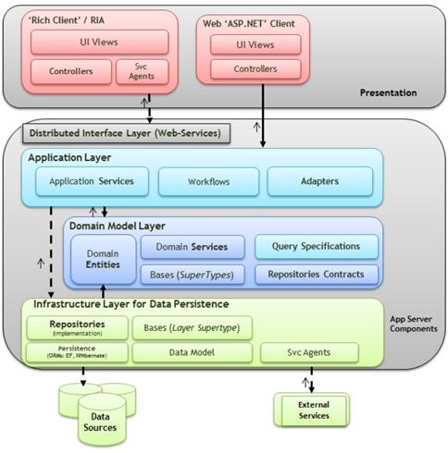

Slide 4
Concepts of Domain Driven Design
Entity: An object that is not defined by its attributes, but rather by a thread of continuity and its identity.
Value object: A value object is an object that contains attributes but has no conceptual identity. They should be treated as immutable.
Aggregate: A group of objects that are bound together by a root entity: the aggregate root. Objects outside the aggregate are allowed to hold references to the root but not to any other object of the aggregate.
Domain Event: A domain object that defines an event (something that happens). A domain event is an event that domain experts care about.
Service: When an operation does not conceptually belong to any object. Following the natural contours of the problem, you can implement these operations in services.
Repository: Methods for retrieving domain objects should delegate to a specialized Repository object such that alternative storage implementations may be easily interchanged.
Factory: Methods for creating domain objects should delegate to a specialized Factory object such that alternative implementations may be easily interchanged.
Ref: Domain-driven design - Wikipedia

Slide 5
Concepts of Domain Driven Design-1
Specification Pattern: In short, specification pattern allows you to chain business queries.
Infrastructure:
Infrastructure contains implementation classes that actually talks to the infrastructure IO, Sql, Msmq, etc.
Domain is the heart of the application not the Infrastructure (this can be hard to grasp if you come from DBA background).
Infrastructure is not important in Domain-design design, it facilitates the application development doesn't lead it.
Infrastructure should not contain any domain logic, all domain logic should be in the domain. (i guarantee that when you first start out, you will put logic in there without knowing it)

Slide 6
Concepts of Domain Driven Design-2
Domain Service
Domain Service allows you to capture logic that doesn't belong in the Domain Entity.
Domain Service allows you to orchestrate between different Domain Entities.
Don't create too many Domain Services, most of the logic should reside in the domain entities, event handlers, etc.
It's a great place for calculation and validation as it can access entities, and other kind of objects (e.g. Settings) that are not available via the entity graph.
Methods should return primitive types, custom enums are fine too.

Slide 7
Concepts of Domain Driven Design-3
Application Service
Application Service is a gateway in to your Domain Model Layer via Dto's (Data Transfer Objects)
Application Service should not encapsulate any domain logic, it should be really thin
Application Service method should do only one thing and do it well with one region of the domain, don't mix it to "make it more performance efficient for the Application that's consuming it".
To access Application Service you expose interface and Dto's for inputs and outputs (it's important not to expose your Domain Entity in a raw format, Dto is a proxy and it protects your domain)
Presenter (mobile app, desktop or web), should call different services to get data it needs and manipulate it to suit the UI. This might seem inefficient, or wasteful at first. You will realise that actually it's just as fast (if not faster), easier to test and maintain.

Slide 8
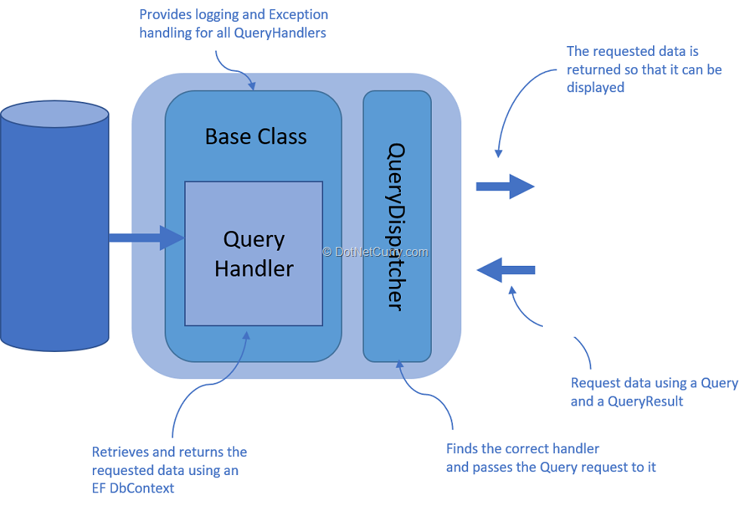
Command Query Separation (CQS)

Slide 9
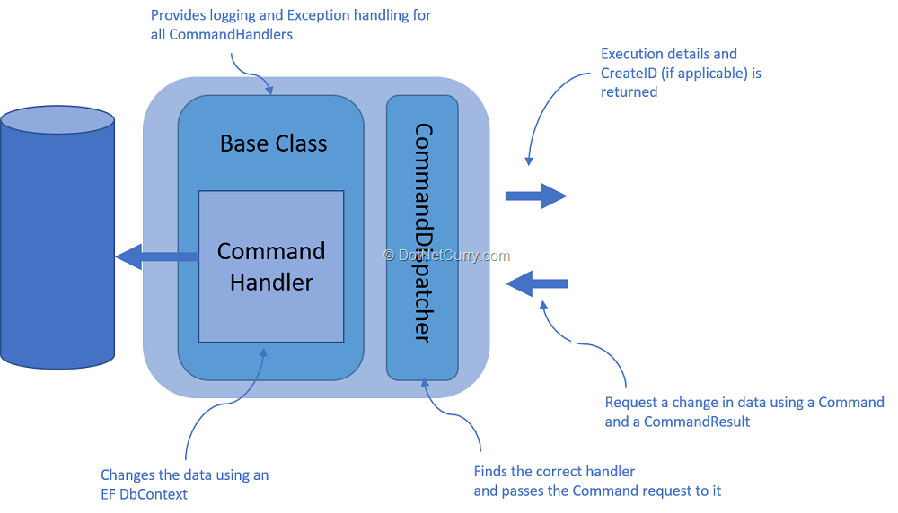
Command Query Separation (CQS)-1

Slide 10
Reference:
zkavtaskin/Domain-Driven-Design-Example: Blog series supplementary domain-driven design C# repository that (hopefully) actually makes sense. (github.com)
Command Query Separation (CQS) - A simple but powerful pattern | DotNetCurry

